Slide 1
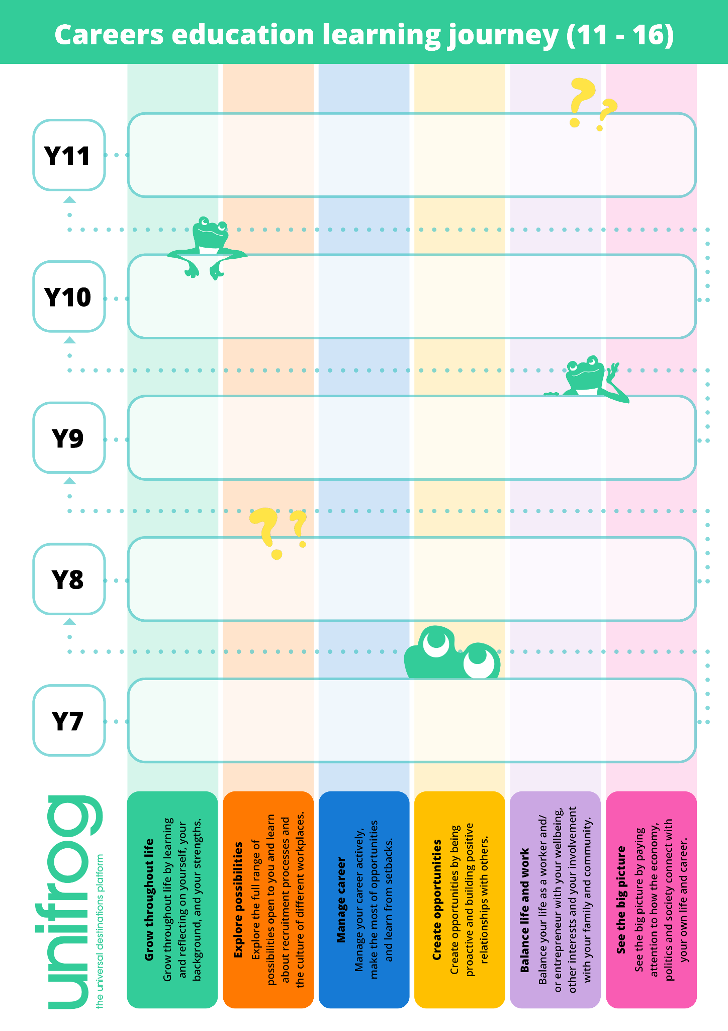
Reflect on your employability skills
Explore pros and cons of P16 options
Learn how to choose a P16 pathway
Explore personal branding
Compare vocational routes and HE
Discuss: is AI a threat to our jobs?
Reflect on your career journey
Explore employer profiles
Learn about different career types
Prepare for work experience
Learn about workplace wellbeing
Explore different working models
Reflect on your skills
Explore P16 routes
Learn how to choose KS4 options
Learn about managing your career journey
Learn how to manage your money
Learn about the labour market (LMI)
Reflect on your interests
Explore a skills profile
Learn about the workplace
Find out how to create the life you want
Define what success looks like
Learn about careers and the climate
Reflect on who you are
Explore dream jobs
Learn what we mean by ‘careers’
Find out what entrepreneurs do
Lean about work-life balance
Learn about careers and the future

