Slide 1
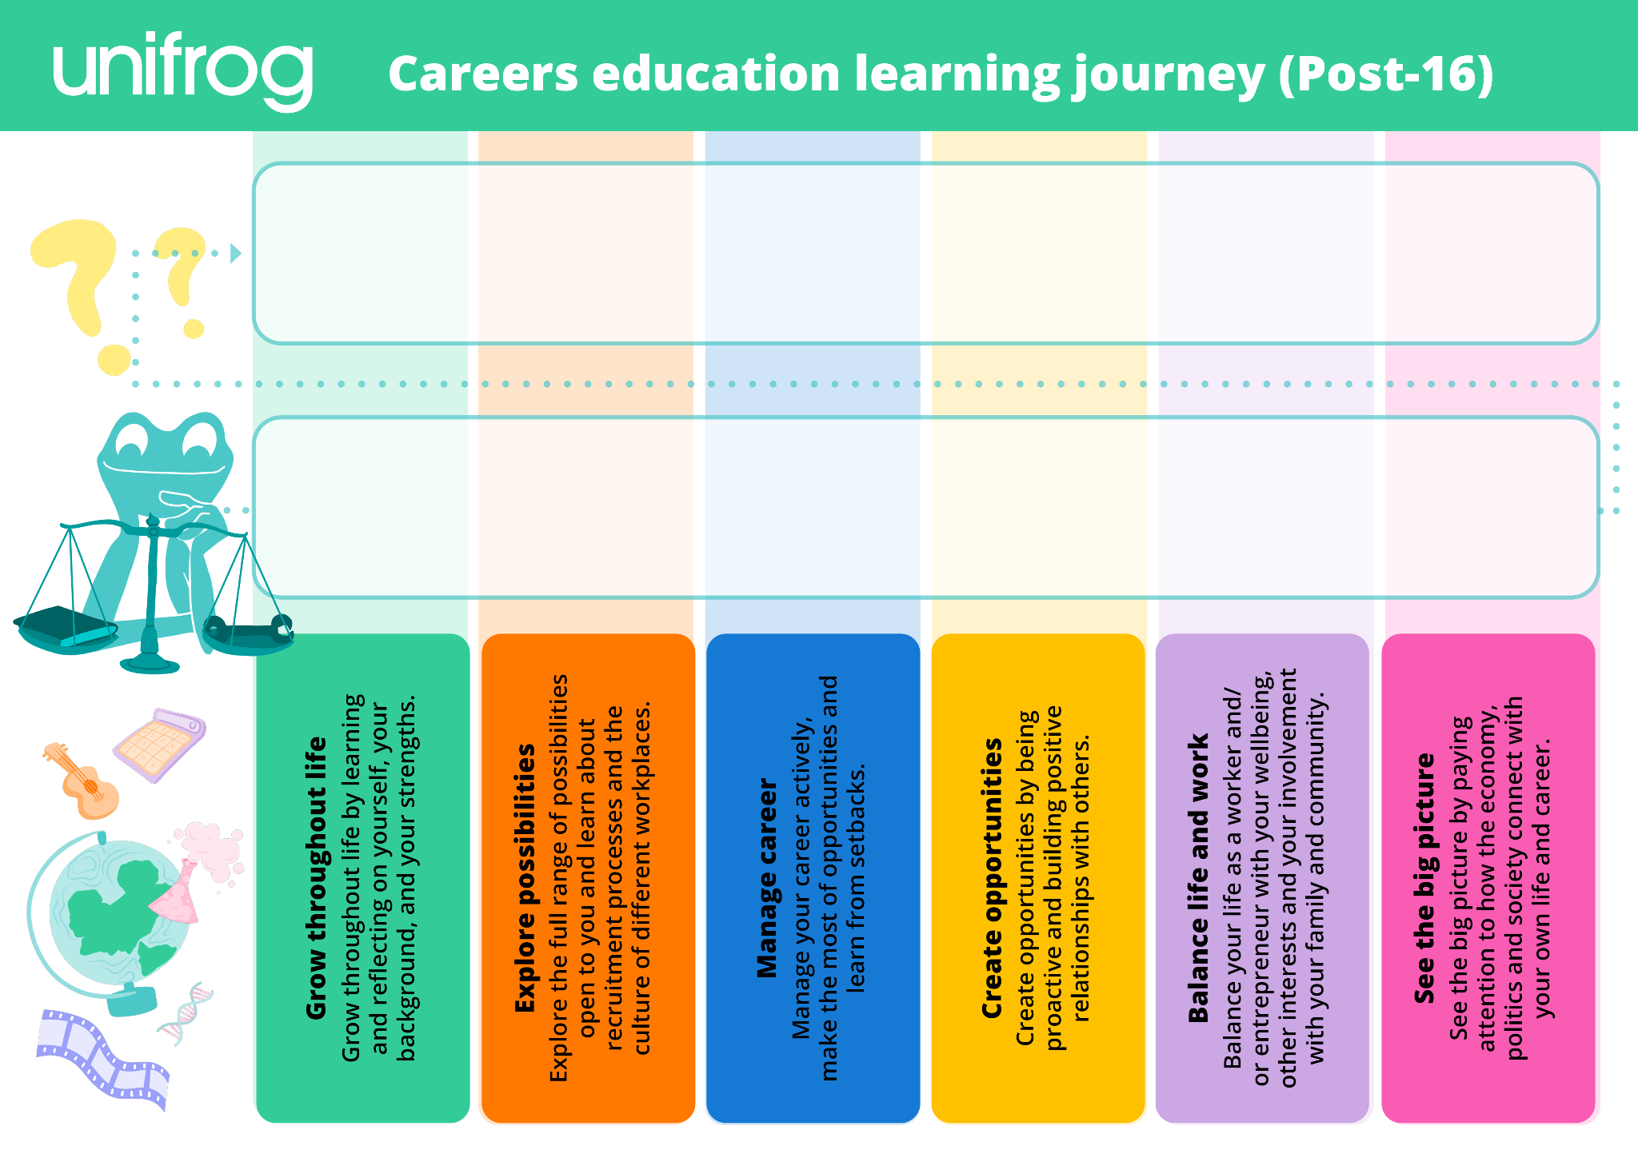
Prepare a CV
Discuss:
Learn how to manage transitions
Learn about volunteering
Think about your personal brand
Speak to employers at the Careers Fair
Discuss:
Prepare for a careers 1:1
Explore pros and cons of post-18 pathways
Learn how to set goals
Learn how to network
Learn to balance life and work

